Slide 1
COVID-19 in China
HS614
Sharon Lee

Slide 2
Goal
Using Johns Hopkins and ACAPS dataset to combine time series data of confirmed, death and recovered cases with safety measures implemented
With the combined dataset, use variables to predict confirmed cases

Slide 3
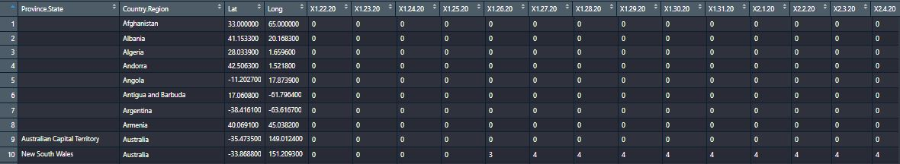
Johns Hopkins dataset
Three separate datasets:
Time series confirmed
Time series death
Time series recovered
For each dataset, extract rows that Country.Region = China
Sum up all rows to obtain accumulated confirmed, death, recovered cases in China -> combine into one dataframe: China
Calculated daily cases using accumulated data

Slide 4
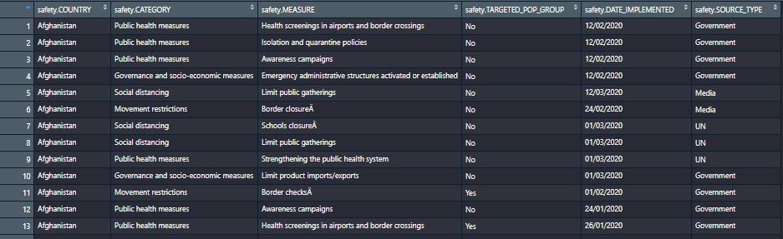
ACaps
Extract rows that have safety.COUNTRY = China
Interested in :
Safety measures
Category
Targeted by pop
Date implemented

Slide 5
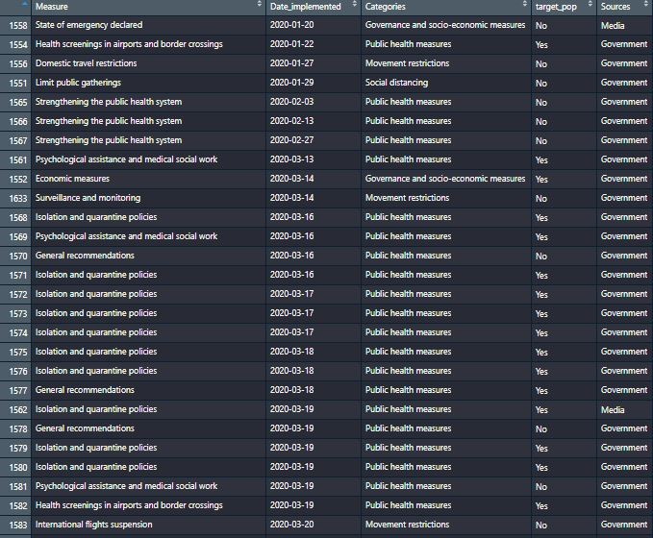
Date implemented issue
Some days have no policy implemented, some days have multiple
Need to integrate into our China dataset
Created a new level: No action taken
For days that are not present in this dataset, when we combine into the China dataset, list that day as “No action taken” for its category, and “No” for target_pop
For days with multiple entries: use first entry for now if different policies were implemented

Slide 6
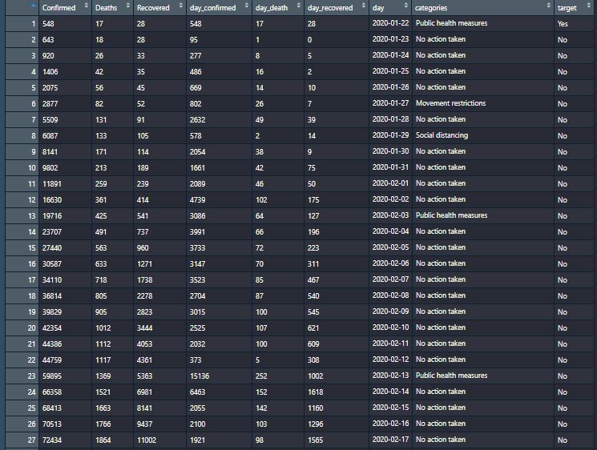
Final china dataset

Slide 7
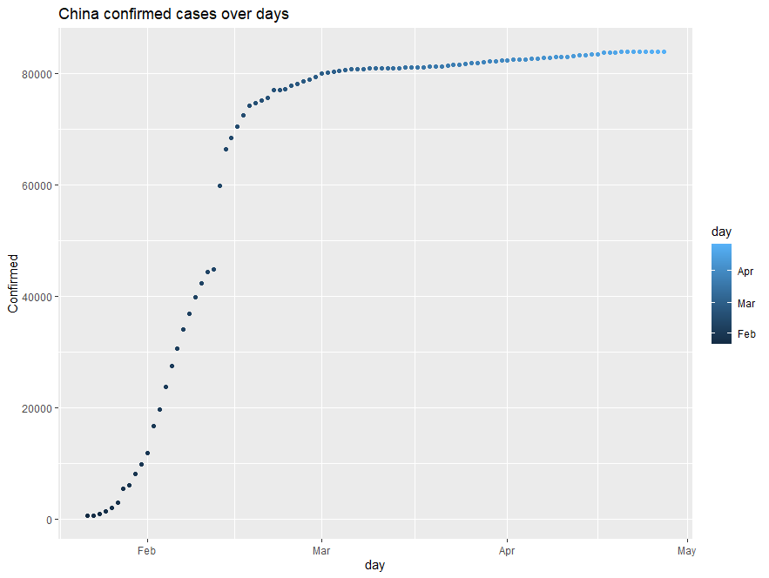
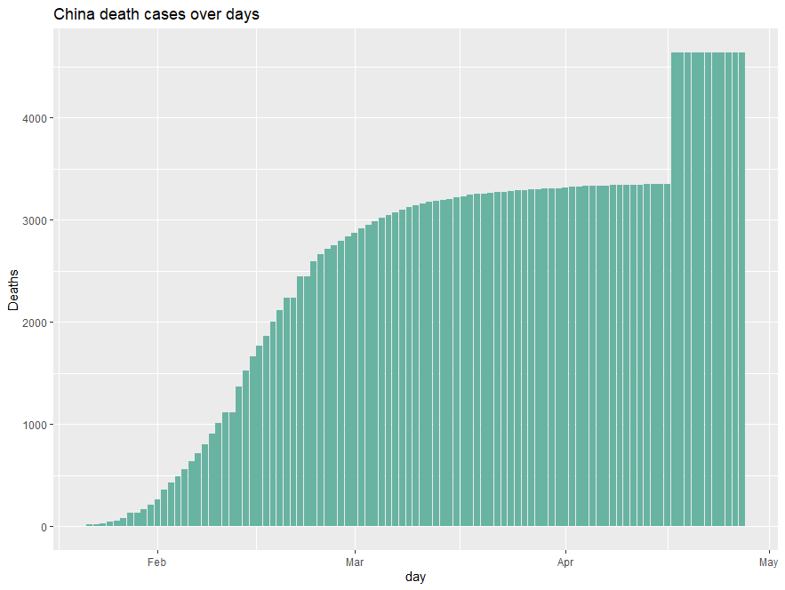
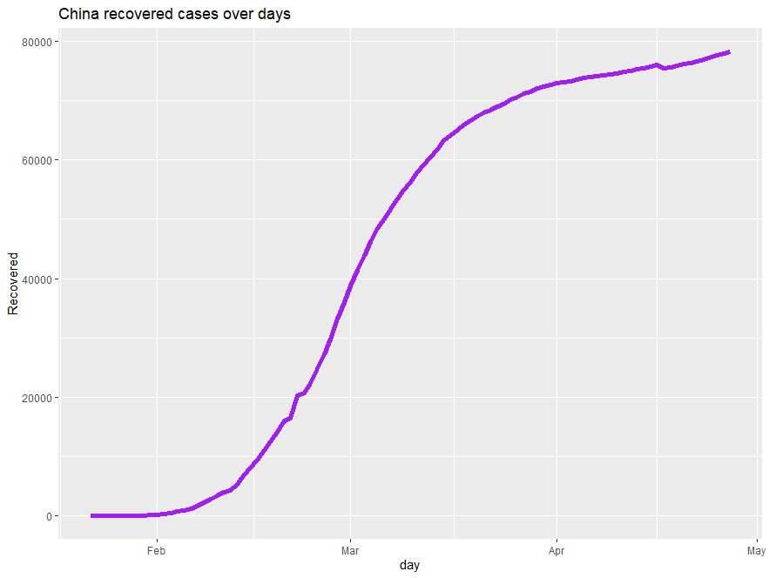
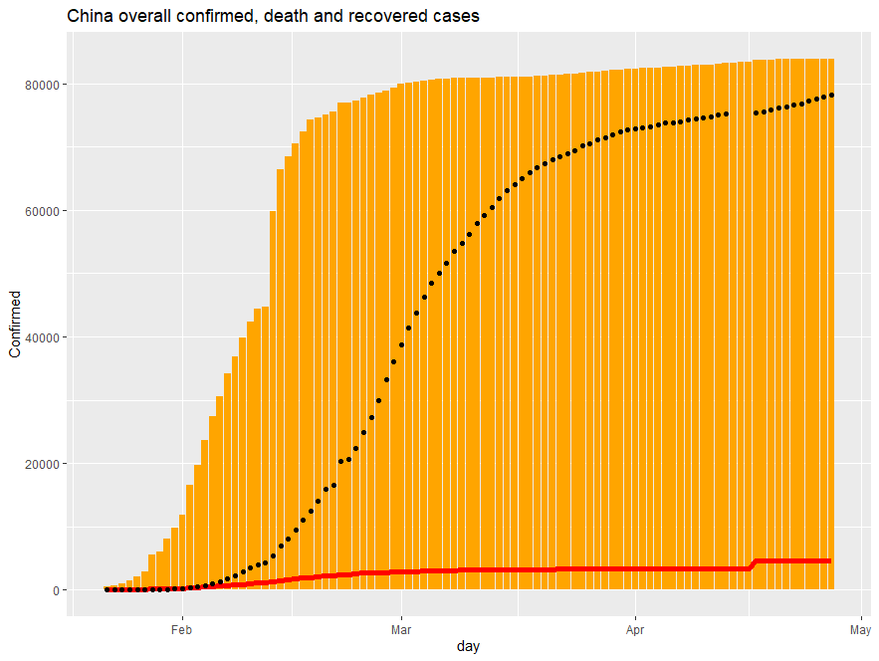
China overall confirmed, death and recovered cases
Overlapping Confirmed, recovered and death cases

Slide 8
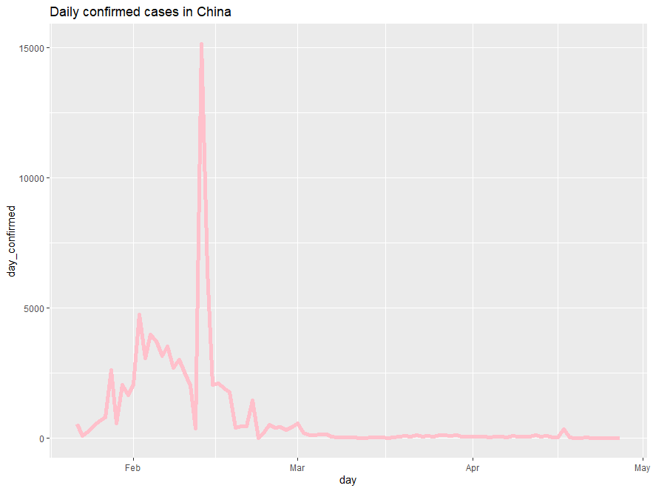
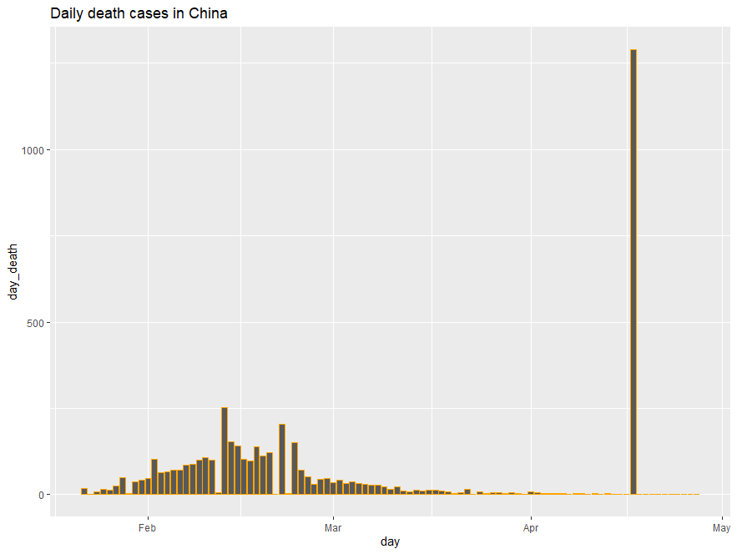
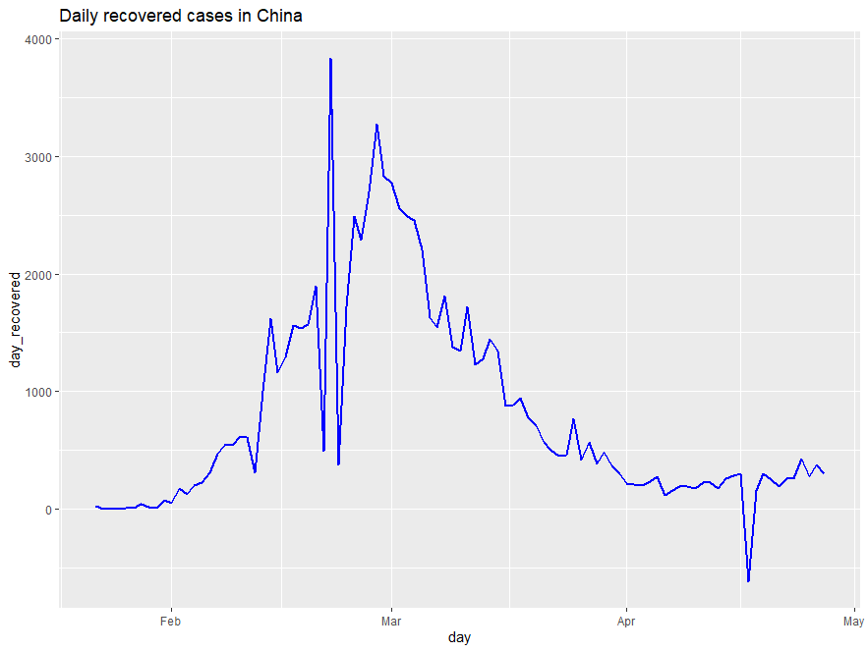
Daily trends
Observed a huge negative spike from daily recovered cases in China:
Converted recovered and daily recovered to NAs for the 3 rows above

Slide 9
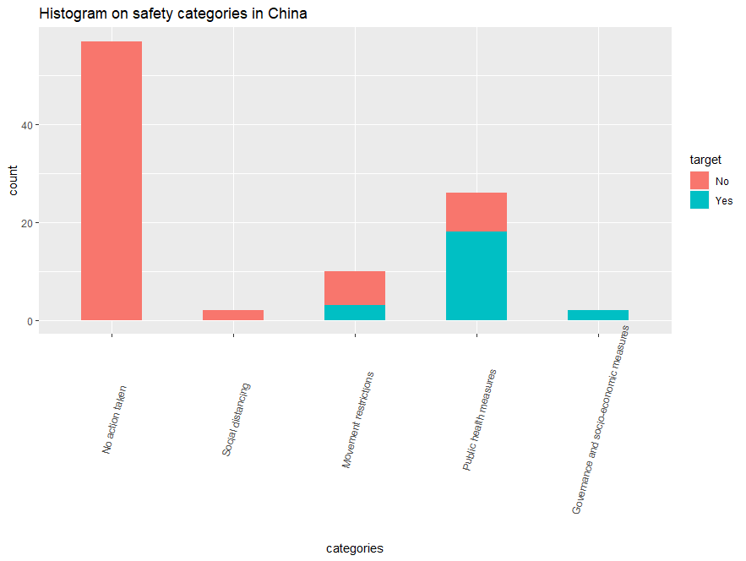
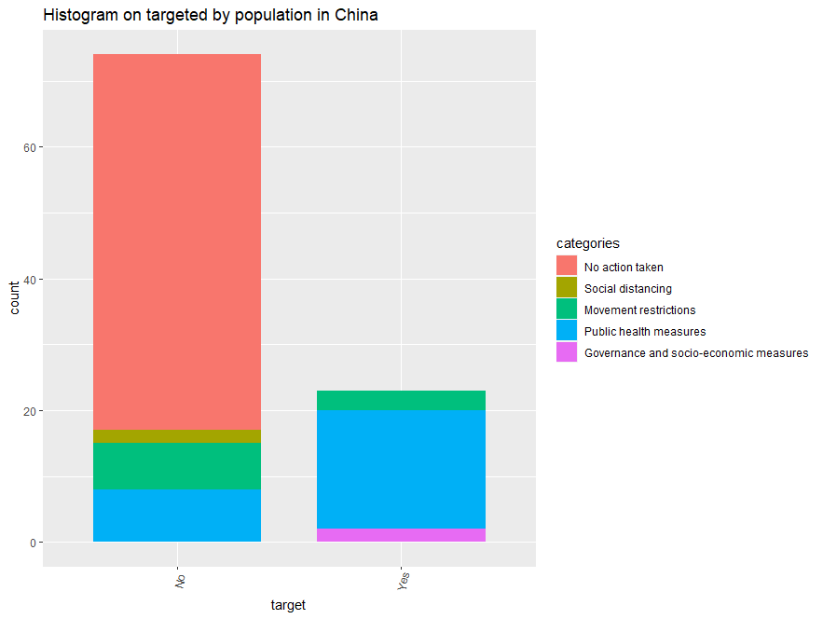
Safety categories and target by pop

Slide 10
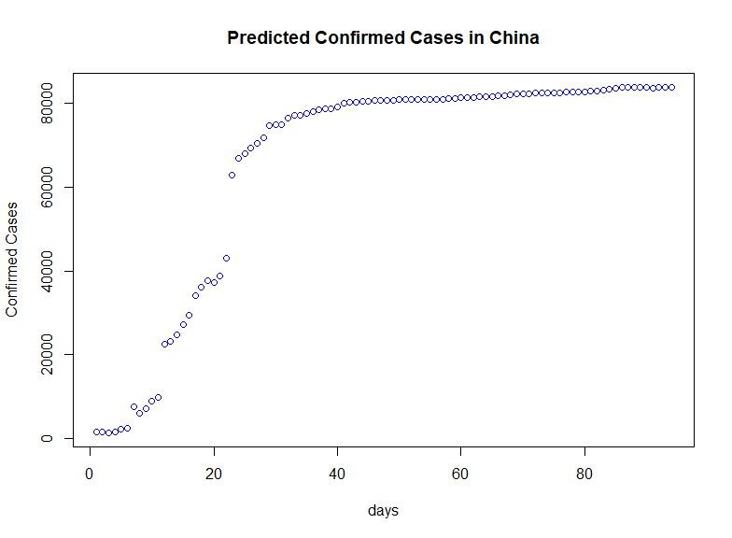
Work in progress
Train 3 dataframes:
China (with all variables) predict Confirmed
China (keep Confirmed, Recovered, Deaths, Categories, Target by pop, days) predict Confirmed
China (keep daily confirmed, daily recovered, daily deaths, categories, target, days) predict daily_confirmed
Training model methods:
Svm radial and linear
Rpart
KNN
Random forest (best result so far) (lowest RMSE)

Slide 11


